Slide 1
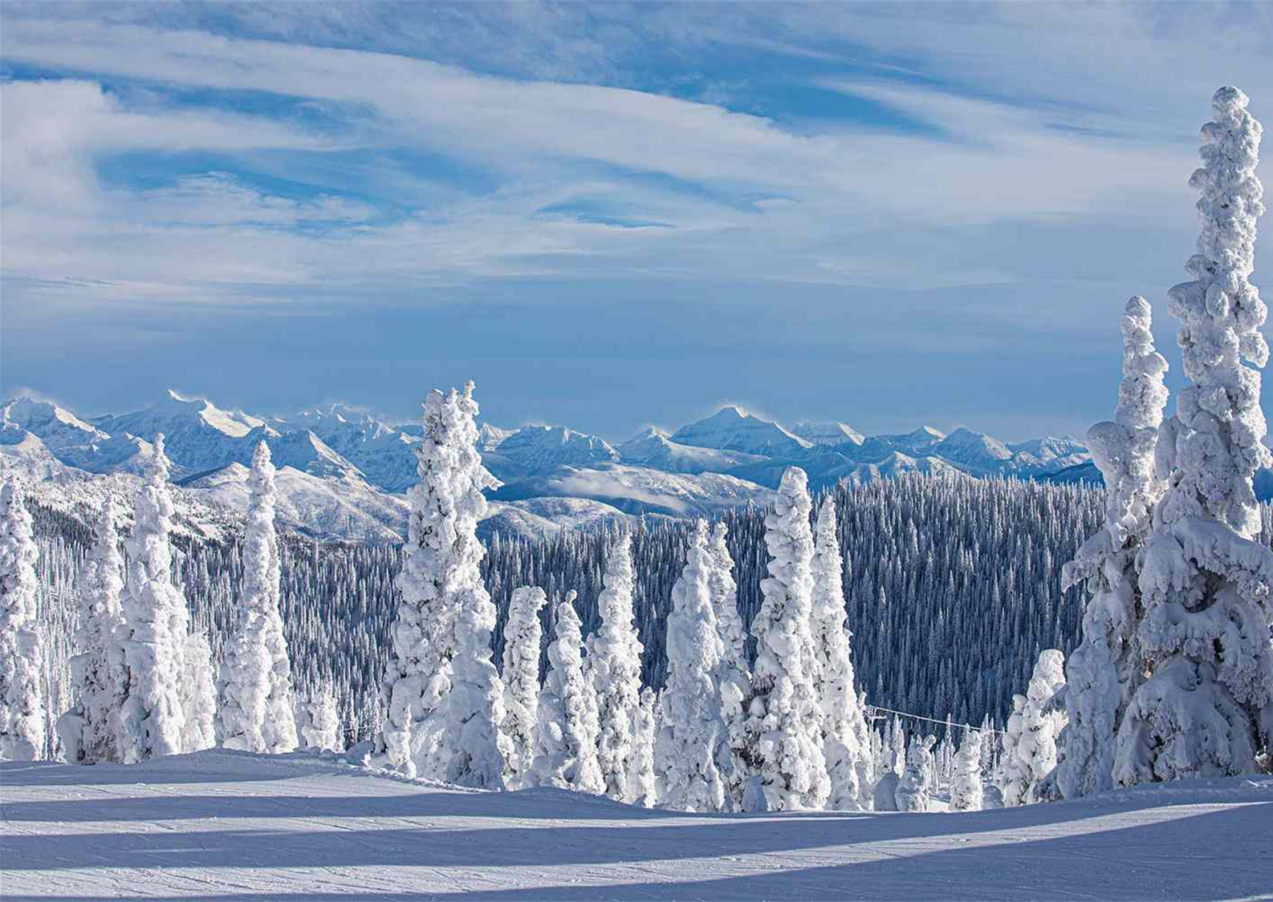
Big Mountain Resort
Ticket Price Evaluation & Feature Insights

Slide 2

Problem Identification
Therefore: what investments and/or price adjustments, if any, can Big Mountain Resort take to maximize its revenue from ticket sales?
Context:
Big Mountain Resort is a premium ski resort located in Montana USA which sees around 350,000 visitors annually.
Problem
Big Mountain Resort is struggling to identify how to correctly price their tickets and what, if any, steps they can take to boost revenue

Slide 3
Recommendation & Key Findings
Current Ticket Price: $81
Recommended Ticket Price: $86+
Potential Revenue Increase: 3.5 million dollars
______________________________________________________________
Additional investments and/or cuts to consider based on future pricing information:
Reduce up to five ski runs
or…
Increase vertical drop
Install additional ski runs & chair lifts

Slide 4
Modeling Results & Analysis
Modeled Ticket Price Prediction for Big Mountain Resort
Expected Ticket Price: $95.87 +/- $10.39
Actual Ticket Price: $81.00
Range of ticket pricing undervaluation: $4.48 – $25.26

Slide 5
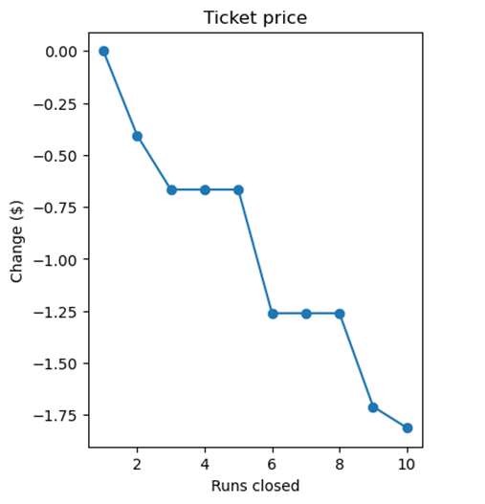
Modeling Results & Analysis
Scenario 1 – Cut Expenses
Reduce ski runs & only
marginally reduce ticket
value
E.g. cutting 5 ski runs reduces
ticket value by ~$0.65

Slide 6
Modeling Results & Analysis
Scenario 2 – Pursue Investments
Do the following
Increase vertical drop by 150ft
Install additional chair lift
Add a single ski run
Increase ticket value by $2
See annual revenue
go up by ~1.4 million

Slide 7
Summary & Conclusion
Question: How can Big Mountain Resort maximize revenue?
Answer: Increase ticket price by $5
Recommendations for future investments and/or cuts
Gather maintenance expenditure for ski runs
Get a quote on how much it would cost to increase vertical drop
Use that information to evaluate if Scenario 1 or 2 boosts profits

